Slide 1

Team Broken Hinges Amogh Varsh 21011102014 Aravind Krishnan 21011102015 Austin Jaison Jose 21011102018 Section : IoT-A

Slide 2
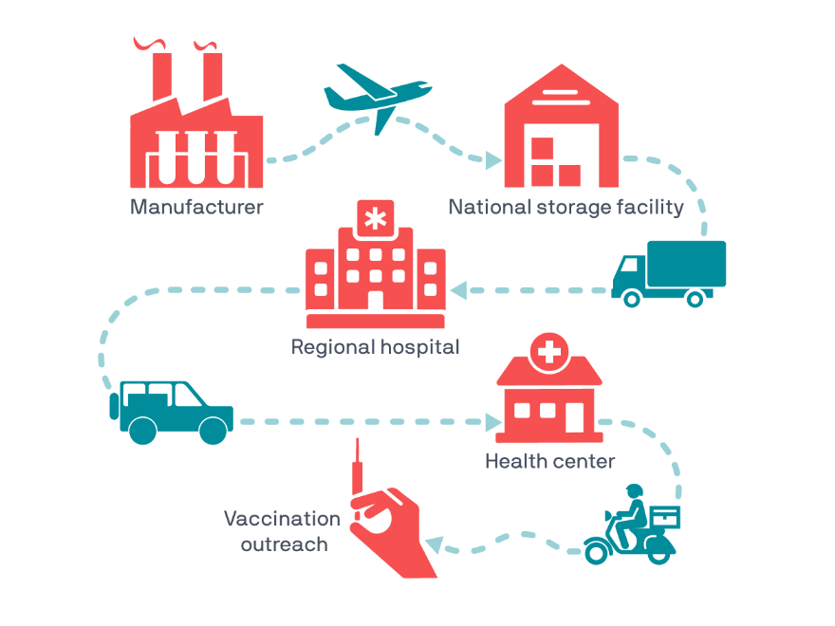
Cold Chain Monitoring
A cold chain is defined as a supply chain with cargo that requires end-to-end temperature control throughout transit. An unbroken cold chain is a sequence of storage efforts that maintain a given temperature range (e.g. 2⁰-8 ⁰C) to transport a sensitive product, including pharmaceutical drugs and biological materials.
Future
SDGs
Survey
Solution
Problem
Prototype

Slide 3
Vaccines require a resilient cold chain with specific requirements for quality assurance
If the cold chain is broken, the product can become damaged, causing it to lose integrity or, in the worst case, harm the patient
The World Health Organization estimates that up to 50% of vaccines are wasted globally every year; a large part because of lack of temperature control and the logistics to support an unbroken cold-chain
Future
SDGs
Solution
Problem
Research
Prototype
Market reputation of the logistics partner takes a hit if they deliver perished goods due to improper maintenance of conditions
Insuring containers with perishable goods such as biopharma is a tough task. When needed to claim the insurance the process is lengthy due to investigations based on arbitrary guesswork

Slide 4
It estimated that the global pharmaceutical logistics market size is expected to grow by a compound annual growth rate of 4.4 percent from 2020 to 2027 and in 2020 it was valued at 77.6 billion
Future
SDGs
Solution
Problem
Prototype
Research
Drivers claiming to have kept the cooling system on whereas they only turn it on during the final stretch of the journey (in our primary research this was highlighted in the logistics of insulin from Pune to Delhi)

Slide 5
Properties :
Secure due to JWT tokens usage for database interaction
Web application handles multiple users and each user can have various trips ,assets and devices to monitor
Dark themed UI to help reduce strain on the ever-looking analysts’ eyes
Real time plotting of charts with inputs received from the device for visual analytics
Future
SDGs
Solution
Problem
Prototype
Research
Functionalities :
Dashboard to display location of selected asset on an interactive map. Also displays concise information of selected trips
Raw Data page to display raw data of the selected device
An integrated alarm generating system which generates alerts when the readings break the specified range
A page displaying all active trips

Slide 6




I2C
Cellular
WiFi
Future
Node
Gateway
Cloud
Web App
SDGs
Solution
Problem
Research
Prototype
Sensors
Thingspeak MQTT Broker
Backend
ESP 32
GSM Module
Fast API
SQL Lite
801S
LDR
Neo 6 M
DHT 22
BMP 180
Frontend
React
Openstreet Map
Chart JS
Tailwind

Slide 7



SDG
SDG
SDG
3
9
17
Good Health And Well Being
Industry , Innovation and Infrastructure
Partnerships For The Goals
Future
SDGs
Solution
Problem
Research
Prototype
Ensuring the quality and safety of pharmaceuticals within the cold chain contributes to better healthcare and well-being by preserving the efficacy of medicines
Our project involves the development of a monitoring application, which falls under the category of innovation and infrastructure development
Collaborative efforts with various stakeholders such as pharmaceutical companies, healthcare providers, and regulatory agencies can help achieve our project’s goals

Slide 8
Blockchain
Safe document sharing
Increases supply chain visibility and transparency
Rightful accountability
Secure document sharing
Prevent counterfeiting by certificates of origin
Cold Storage Monitoring
Storage of pharma products in warehouses can also be brought under monitoring
Future
SDGs
Solution
Problem
Research
Prototype
Multiple
To add multi device control and monitor it all through one screen

